Slide 1

Boston Transit Database Management System
Group 9 : Uddhav Zambare Yugal Lakhyani
Suhasini Polampelly
Lokanatha Aditya Kotla

Slide 2
Project And It’s Purpose
ABOUT It’s a comprehensive database system, designed to manage the operations of the Massachusetts Bay Transportation Authority (MBTA) system in Boston. The project covers a wide range of functionalities, including personnel management, route planning, rider information, financial transactions, and incident tracking.
PURPOSE
1
Study and Implementation
The primary purpose is to study the design and implementation of the centralized database system for BT's records management.
2
Data Collection and Management
Collect and manage data on schedules, routes, vehicle assignments, service disruptions, budgets, expenditures, revenue, maintenance schedules, repairs, and more.
3
Understand Data Accuracy and Reporting Techniques
Improvement in data accuracy, security, retrieval efficiency, and reporting through centralization, standardization, and streamlined processes.

Slide 3
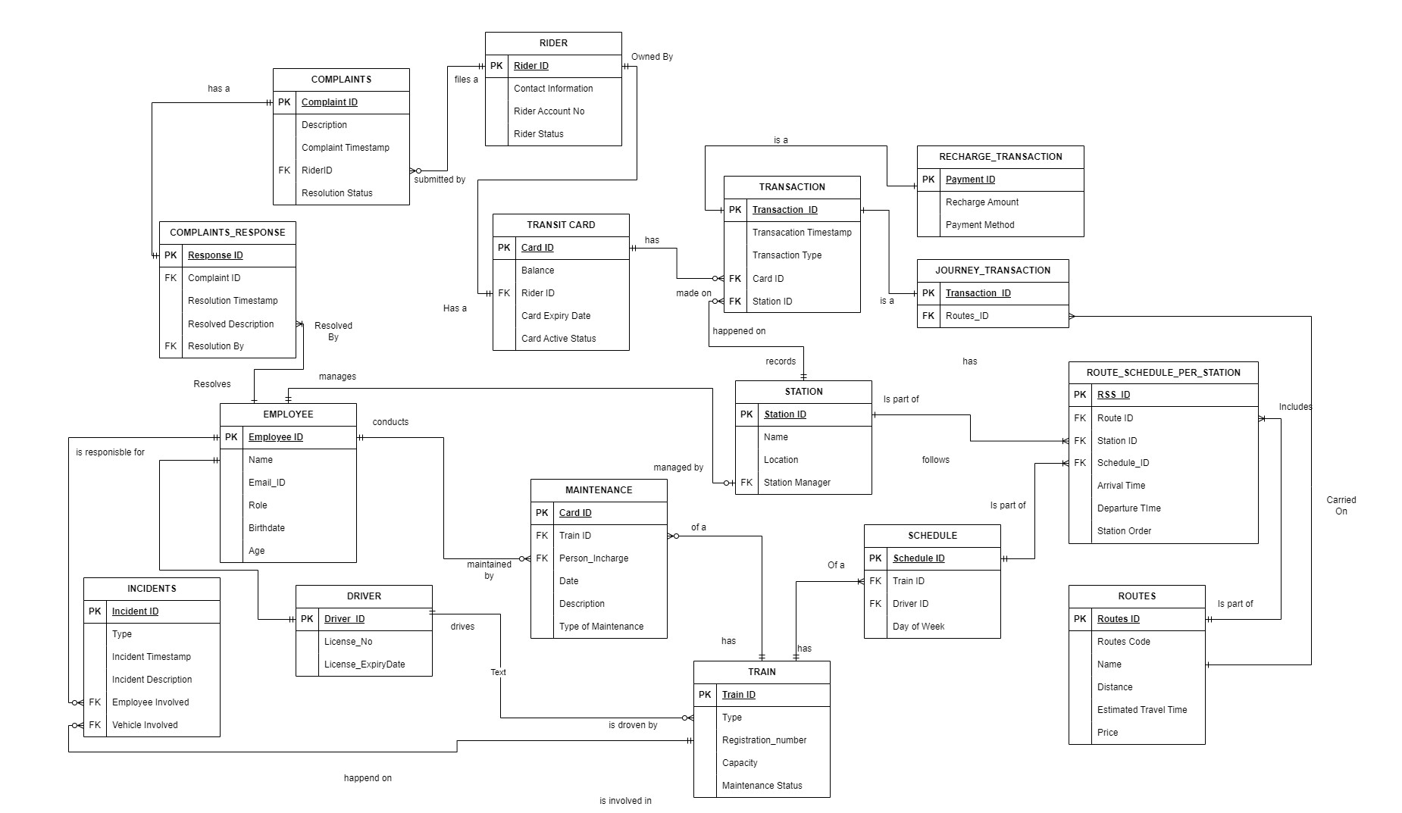
Entity Relationship Diagram (ERD)

Slide 4
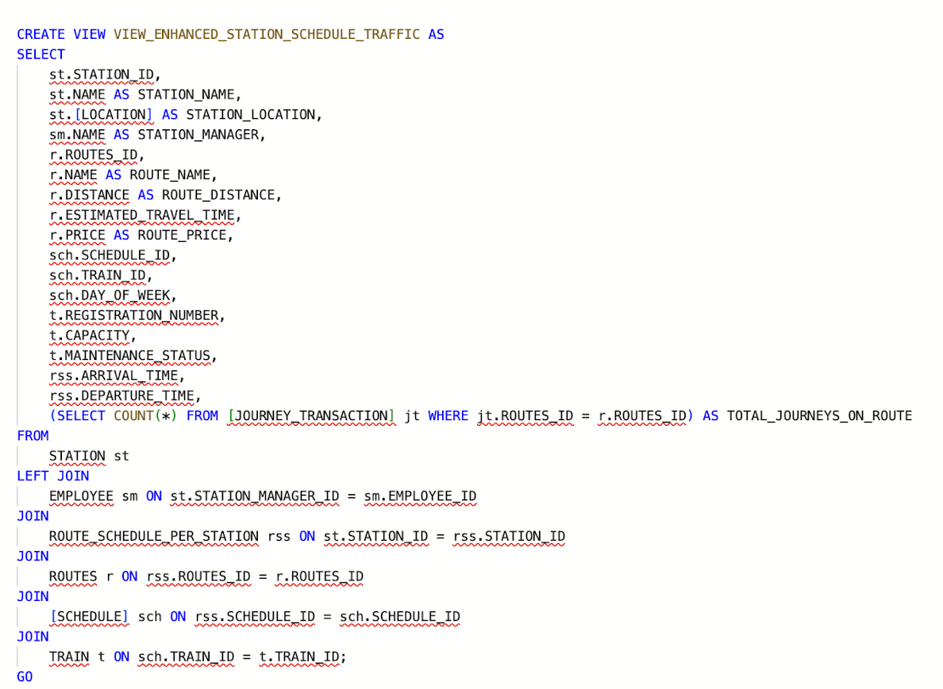
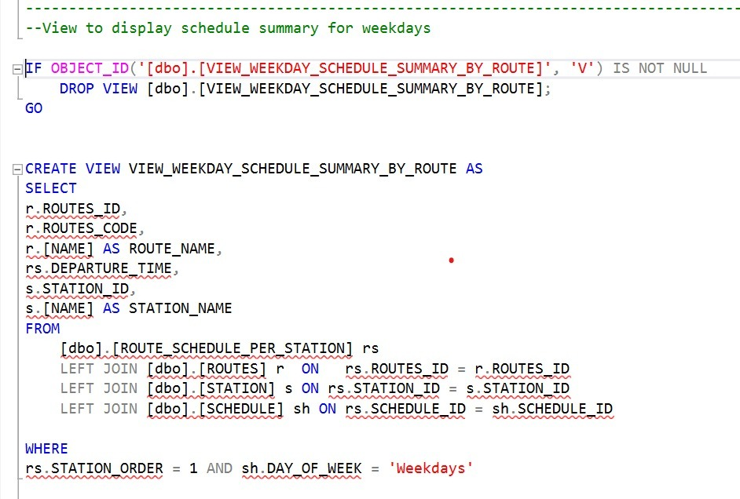
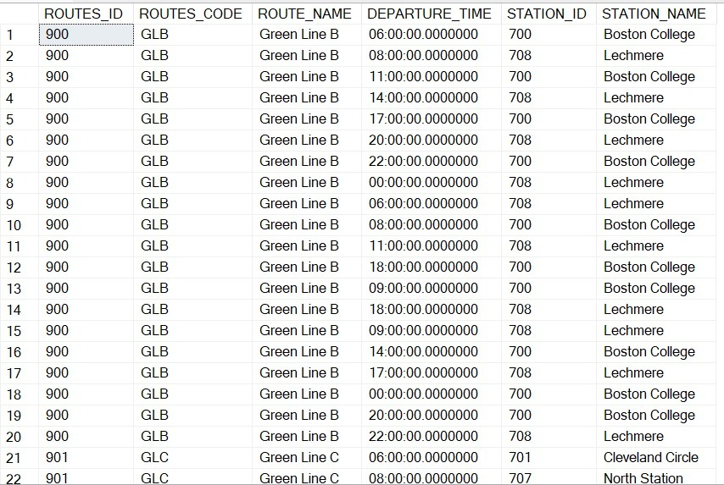
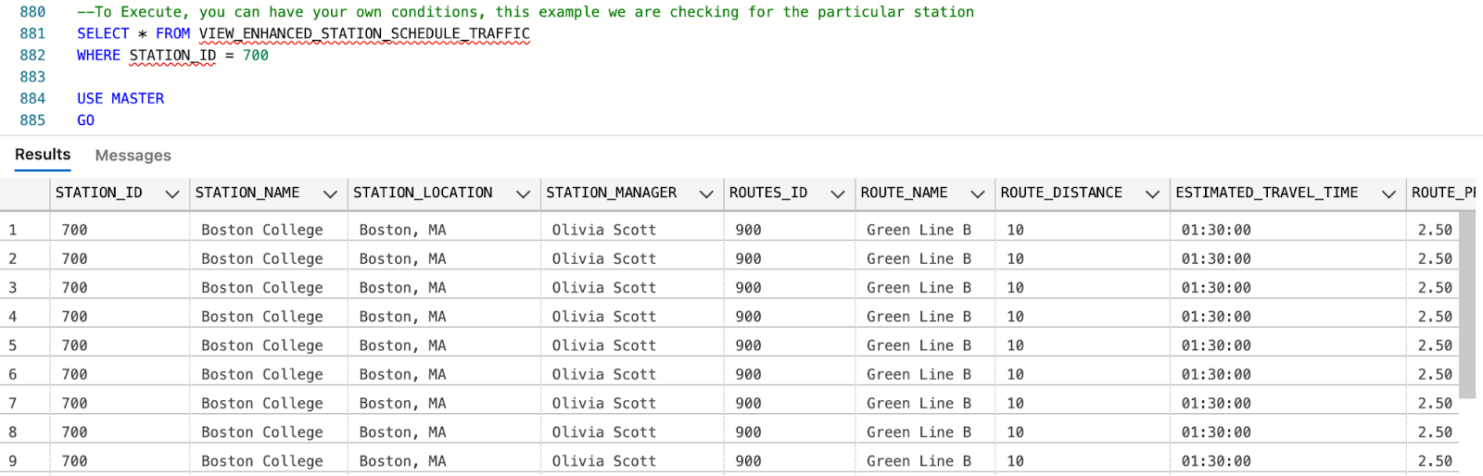
VIEWS
VIEW_ENHANCED_STATION_SCHEDULE_TRAFFIC
A detailed view that integrates data from STATION, EMPLOYEE, ROUTE_SCHEDULE_PER_STATION,
ROUTES, SCHEDULE, and TRAIN tables.
Provides an extensive overview of each station, including station details, route and schedule information,
train details, and maintenance status. This view is particularly useful for understanding station schedules,
traffic, and overall operational aspects.
VIEW_WEEKDAY_SCHEDULE_SUMMARY_BY_ROUTE:
A summarized view that derives data from ROUTES, STATION, SCHEDULE to display Schedule summary by routes for weekdays.
This is further being used in PowerBI report.
OUTPUT
OUTPUT

Slide 5
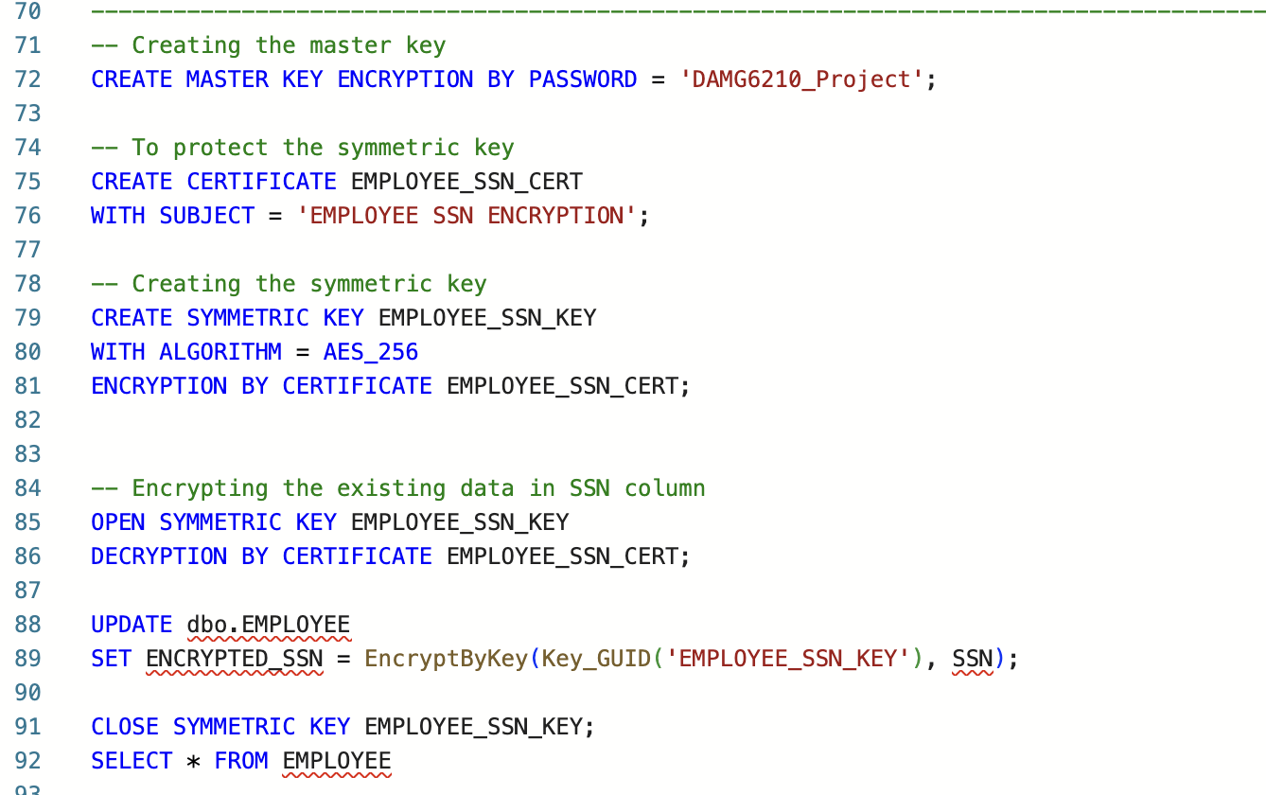
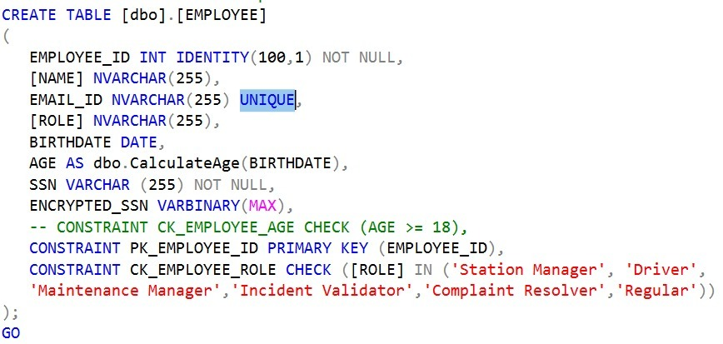
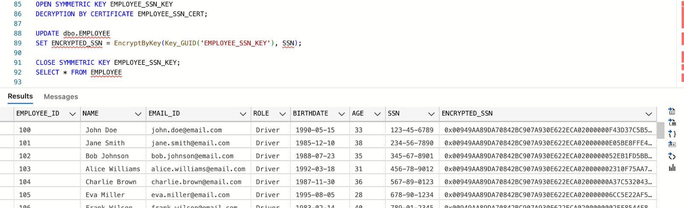
Encryption of column
Non-clustered index
Encryption Setup for SSN Column
A security framework within SQL Server involving a master key, a certificate, and a symmetric key to encrypt sensitive employee Social Security Number (SSN) data.
Enables secure storage of SSN data by encrypting it before insertion into the database and allows for secure decryption for authorized viewing and verification.
Non-Clustered Index on [EMPLOYEE]
A non-clustered index was created on column EMAIL_ID in EMPLOYEE table using UNIQUE constraint
Optimizes search queries based on EMAIL_ID, improving query performance for operations that involve filtering or sorting by this column.
User Defined Functions
dbo.CalculateAge
Calculates the age of an individual based on their birthdate.
Parameters: @Birthdate (DATE)
Output: Integer representing the calculated age.
OUTPUT

Slide 6
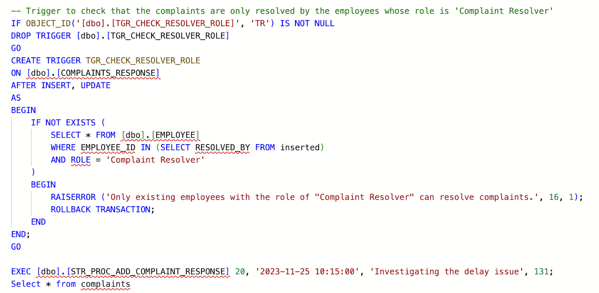
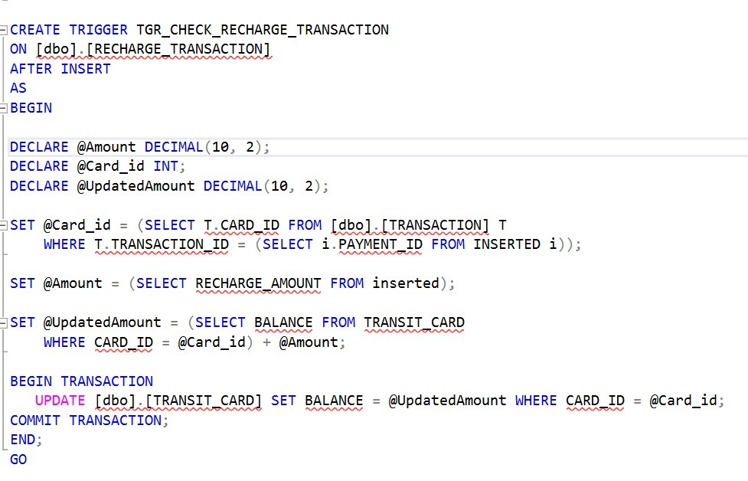
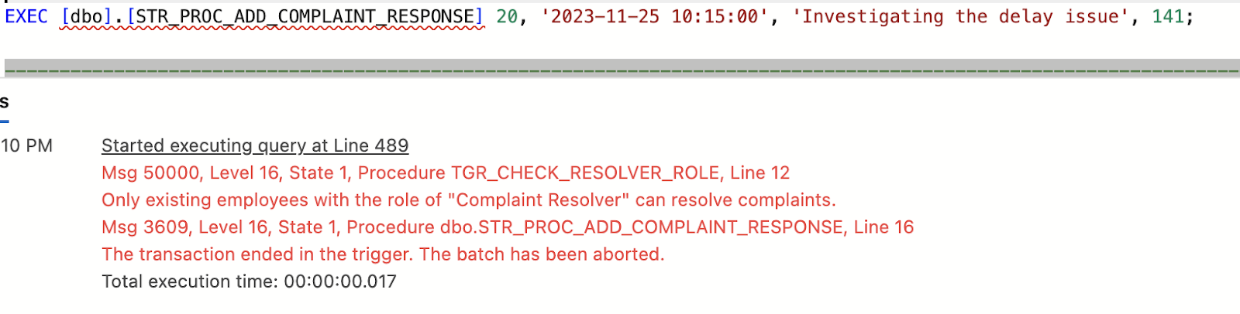
TRIGGERS
TGR_CHECK_RESOLVER_ROLE
An AFTER INSERT, UPDATE trigger on the [dbo].[COMPLAINTS_RESPONSE] table.
Ensures that complaints are resolved only by employees with the 'Complaint Resolver’ role, maintaining role-specific restrictions for complaint resolution.
TGR_CHECK_RECHARGE_TRANSACTION
An AFTER INSERT, trigger on the [dbo].[RECHARGE_TRANASCTION] table
Updates TRANSIT_CARD balance after addition of recharge transaction.
OUTPUT

Slide 7
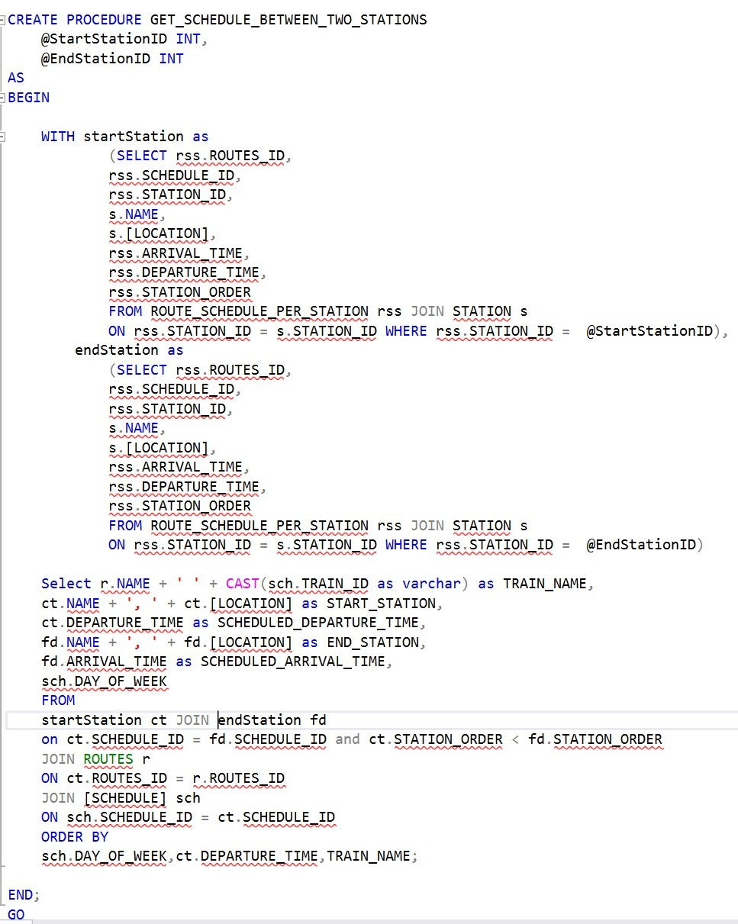
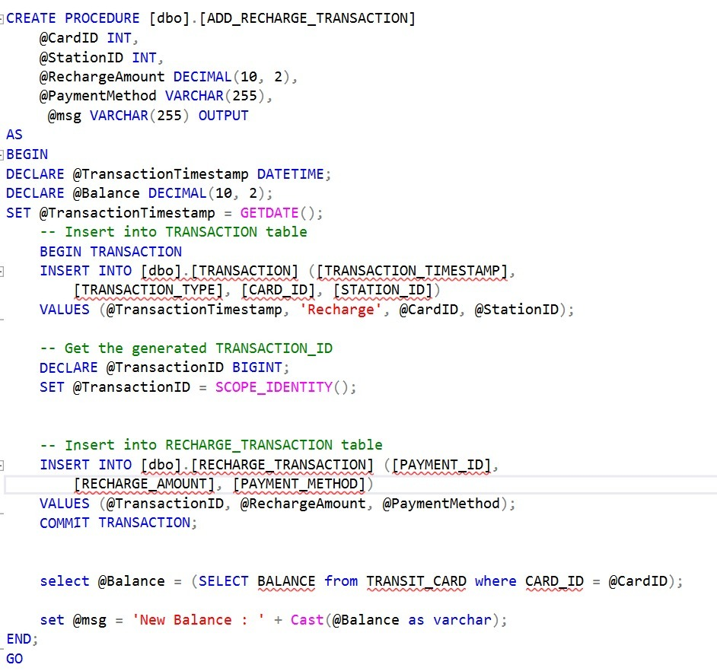
STORED PROCEDURES
STR_PROC_GET_SCHEDULE_BETWEEN_TWO_STATIONS
Retrieves the train schedule between two specified stations.
Parameters: @StartStationID, @EndStationID
Output: Result set with train names, start and end stations, and scheduled times.
ADD_RECHARGE_TRANSACTION
Procedure to insert data regarding Recharge happening on a Transit Card ID
Parameters: @CardID, @StationID, @RechargeAmount, @PaymentAmount
Output: Updates TRANSACTION, RECHARGE_TRANSACTION and TRANSIT_CARD

Slide 8
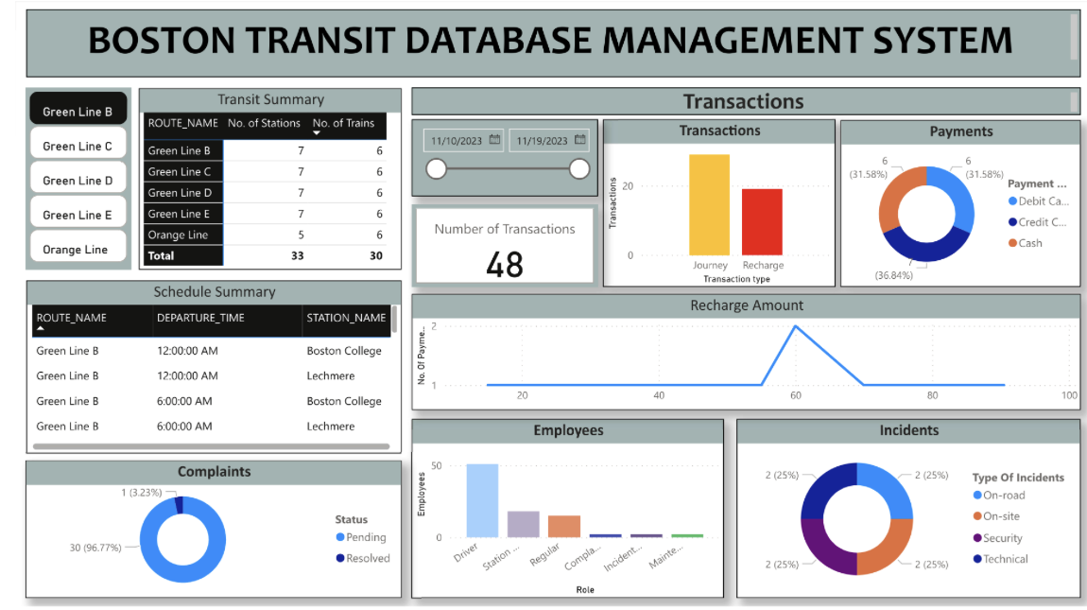
POWER BI REPORT

Slide 9
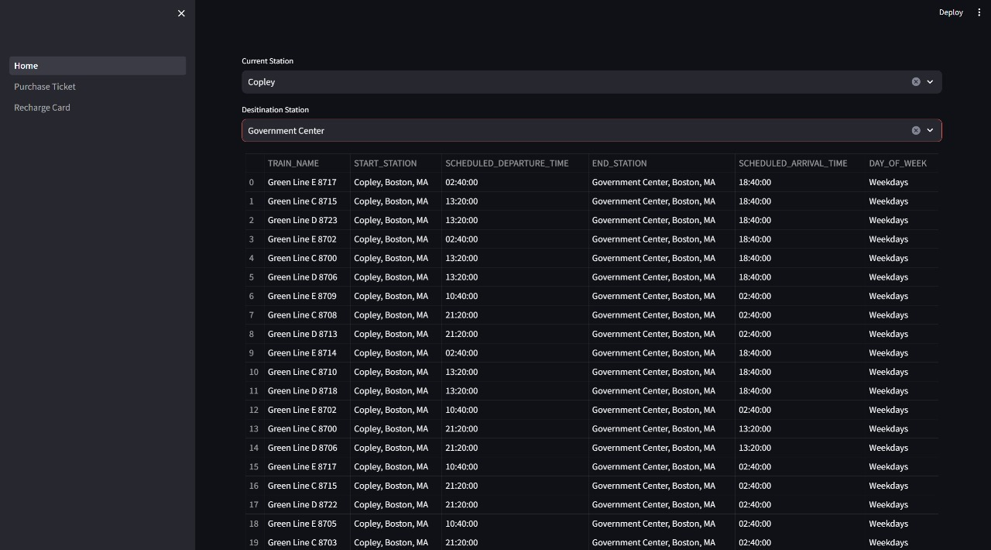
GUI for Schedule and Transactions

